Slide 1
Alfred Adler (1870-1937)
Was born “skinny, weak, and sickly” (from undiagnosed conditions).
Became a medical doctor, and his first interest was in organ inferiority and compensation.
  Compensation – adjusting to weaknesses by developing other strengths.
  Overcompensation – focusing on a weakness until it becomes an exaggerated strength (real or fictional).
This approach to organ inferiority showed his interest in relating psychology and health.

Slide 2
Adler and Freud
With his interest in relating psychological issues to physical (health) issues, Adler published a strong defense of Freud’s psychoanalysis in 1907.
Freud was impressed with him, and that same year invited him to be part of Freud’s discussion group, which evolved into the infamous Vienna Psychoanalytic Association.
Adler joined the group, and quickly became an influential member. But, he also disagreed with Freud frequently, and by 1911, Adler and his supporters broke off from Freud to start their own psychoanalytic group.

Slide 3
Adler’s Approach:
Individual Psychology
By 1910, Adler had started to look at compensation as an independent psychological process. In other words, he started to view personality differences as stemming from individual differences in compensating for weaknesses.
Based on Nietzsche’s will to power concept, Adler concluded there was an innate driving force behind our behaviors and experiences. At first, he called it “striving for superiority.” Later, he called it “striving for perfection.”

Slide 4
Break with Freud
Disagreed w/Freud regarding biology and sexuality, in particular, Alder opposed the predominance of sexuality.
Instead, Adler stressed the importance of psychological (personality) factors over instinctual biological drives.
Saw himself as a colleague, not a disciple of Freud.

Slide 5
Striving for Perfection
Adler developed a complete psychological model based on the innate driving force of “striving for perfection.”
As with Freud, Adler’s model also evolved over the years.
The distinction within Adler’s word-change reflects the nature of Adler’s driving force …
  Superiority – relative and tangible.
  Perfection – personal and unattainable.

Slide 6
Striving for Perfection (continued)
The “striving” is not necessarily ‘towards’ anything, but ‘away’ from feelings of inferiority.
We will always have some feelings of inferiority, even if we achieve some superiority. “To be a human being means to have feelings of inferiority.”
The unattainable “perfection” is a reflection of our continuous internal driving force.
It is all based on a drive to overcome (compensate for) our feelings of inferiority, so significant failures might lead us to develop inferiority complexes.

Slide 7
Inferiority Complex
A person may become unable to overcome feelings of inferiority, making it a complex.
The common reaction to feelings of inferiority is overcompensation - denying having the “weakness.”
It can result in mental illness if the person seeks superiority by being either domineering over others or over-dependent on others who are not suffering from the same weakness.
In such situations, the driving force is to overcompensate for weakness by exerting control of others who do not have the same weakness.

Slide 8
Superiority Complex
Exemplifying the classic case of over-compensation, a person can address inferiorities by developing a superiority complex.
Individuals suffering from a superiority complex deal with their own inferiorities by trying to make others seem even more inferior.
The primary examples are bullies, braggers, and the dictatorial authority figure. More subtle examples are the thrill-seeking-criminal and using drugs or alcohol to feel “superior” to others.

Slide 9
Society and Life
Overall, Adler proposed that we create social values, then strive to overcome our feelings of inferiority by fulfilling important social values.
Adler assumed life was inherently meaningless. Hence, we must create values, drives, and problems that are relevant to society (comparable to Lewin).
“Striving for superiority” reflects the idea that our feelings of inferiority are based on social comparisons. However, we can “strive for perfection” by pursuing selfish goals as meaningful “fictions”.

Slide 10
Fictional finalism
Based on Vaihinger’s “as if” philosophy, Adler incorporated the notion of fictional finalism.
We all create “fictions” in our life which have no relation to reality. (e.g. all men are created equal)
We start developing such fictions in childhood, to help us deal with the challenges we encounter in everyday life. .
With fictions, we can create subjective causation, such as “good guys will always win in the end.” (Our subjective causes are rarely true).
With subjective causes, our fictions can give us goals (for overcoming our feelings of inferiority), and ultimately create our lifestyle.

Slide 11
Life Style
Our life style is who we are (personality). It is Adler’s counterpart to Freud’s “ego.”
It includes the fictions (defense mechanisms) we use to define our world, our goals, and our unique means of striving for goals (overcoming inferiority), as well as hereditary and environmental barriers.
Factual or fictional, Life Style reflects our “creative power of self.”
Ultimately, success is our ability to fit into our environment while being true to ourselves.

Slide 12
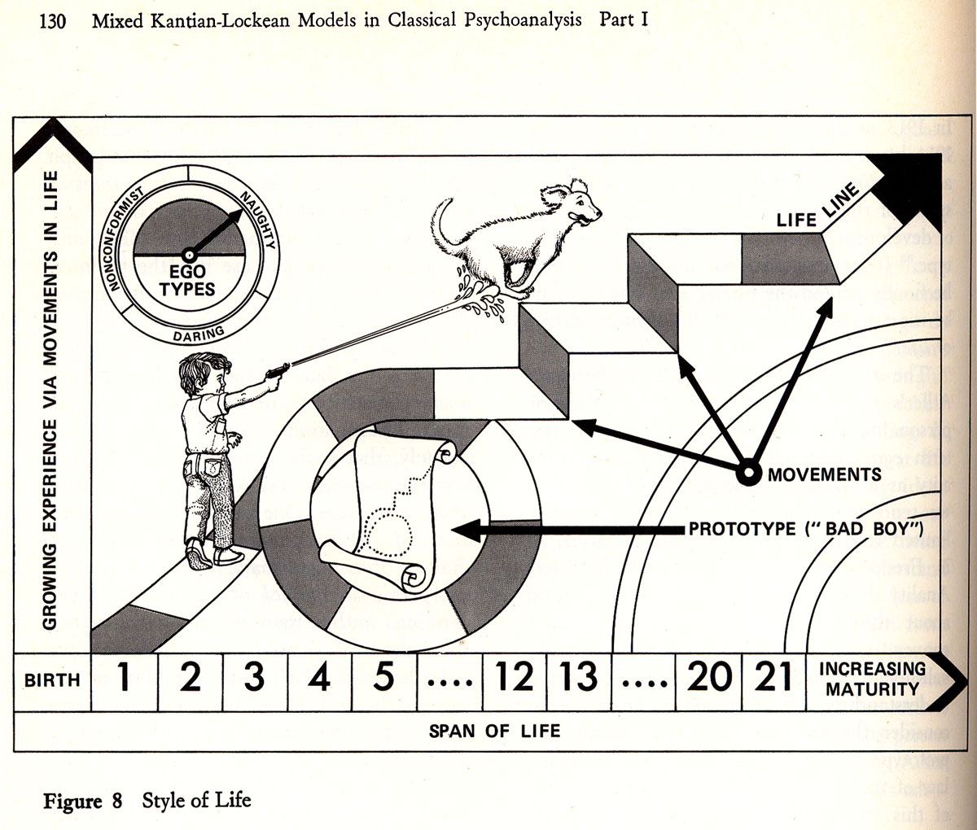
Style of Life or Personality

Slide 13
The Socially Useful Person
Adler believed that maturity, intelligence, and “being normal” was all based on our ability to feel for and help others – be a humanitarian!
We strive to be socially useful because it helps us overcome feelings of inferiority. In turn, we judge ourselves based on our usefulness to society.
Someone who is useful to society is someone who makes a “good adjustment” to society. A useless person is someone who made a “bad adjustment.”

Slide 14
The Socially Useful Person (continued)
Created four typologies, based on levels of social interests and social activity.
  Socially useful – high social interest, highly active.
  Ruler – low social interest, highly active.
  “Getting” person – high social interest, low activity.
  Recluse – low social interest, low activity.
A genius is an extremely useful person, but it is the recognition of her/his usefulness' is what makes a person a true genius.

Slide 15
ADLERIAN THERAPY
All behavior is goal-directed & purposeful
People initially feel inferior to others and develop an inferiority complex
People who overcompensate their feelings of inferiority develop a superiority complex
Future goals influence people as much their past

Slide 16
Birth Order Matters
Firstborns – monarch of the family, receive all the attention, the parents practice on them. They strive to achieve, behave and please. Are parent substitutes for their siblings. When another sibling is born, they are dethroned and may become resentful or overcompensate with power and authority

Slide 17
Birth Order…
Secondborns – don’t worry about power and authority, are never dethroned. Usually are more outgoing, carefree and creative and less concerned with rules. Usually are the opposite of the firstborn.

Slide 18
Birth Order…
Middle children – feel squeezed in & treated unfairly. They learn the art of negotiation & understand family politics. Often are manipulative and make reasoned choices to about where to find success

Slide 19
Birth Order…
Youngest children – receive a great deal of attention from others, expect others to care for them. Can be quite charming and funny but have a hard time breaking out of the baby role. Can become spoiled but often can be quite successful if the older siblings are good role models

Slide 20
Birth Order…
Only children – seven year gaps start with new family or become only children. They are never dethroned and gain a lot of attention. They mature early and are high achievers. Quite imaginative due to having to entertain themselves. They can become pampered and selfish and may not be well socialized.

Slide 21
Role of Style of Life
By the time a person reaches the age of five, s/he develops a lifestyle. This is a way of pursuing long-term goals. This lifestyle develops thru the person’s perception of the family atmosphere.

Slide 22
Fact or Fiction
Subjective evaluations of themselves was called a fiction:
Overgeneralizing – viewing everything as the same
False or impossible goals of security – trying to please everyone

Slide 23
ADLERIAN THERAPY
Misperception of life & life’s demands – believing that one never gets any breaks
Minimization or denial of one’s worth – thinking that one will never amount to anything
Faulty values – believing in the necessity of being first no matter what needs to be done to achieve that goal

Slide 24
Treatment Strategies
Placed emphasis on contributing to society
Work is required for human survival and teaches interdependence
Sexuality must be defined in regard to self & others in a cooperative, rather than a competitive spirit
Courage – a willingness to take risks w/o knowing what the consequences may be

Slide 25
Treatment Strategies
Establishing a therapeutic relationship is of utmost importance
Analysis of lifestyles, family constellations, early memories, dreams, priorities and ways of responding
Promote insight thru open-ended questions, interpretations
Use of counselor empathy is important

Slide 26
Treatment Strategies
Confrontation – consider private logic
Asking the question – what would be different if you didn’t have this situation?
Encouragement – faith in the person
Acting “as if” – be what you want to be
Spitting in the soup – point out behaviors to ruin the payoff for the behavior

Slide 27
Treatment Strategies
Catching oneself – teaching people to become aware of self-destructive behavior
Task setting – initially set short-term goals and work up to long-term goals
Push button – you can choose to remember positive as well as negative experiences

Slide 28
www.youtube.com/watch?v=NyZCZTPhJq0
www.youtube.com/watch?v=UZYHe8IAlto

